Slide 1
Ironhack Project
Image Classification with CNN
A deep learning approach to 10-class animal detection

Slide 2
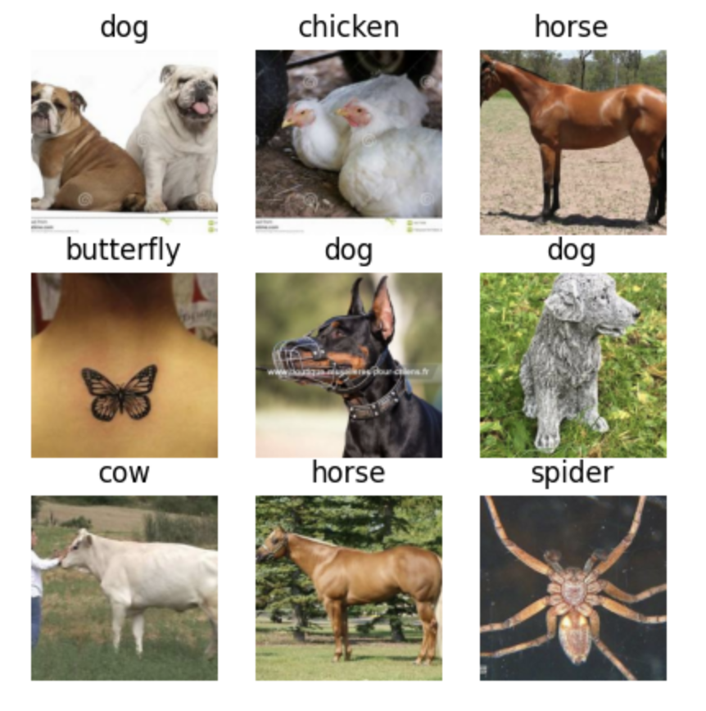
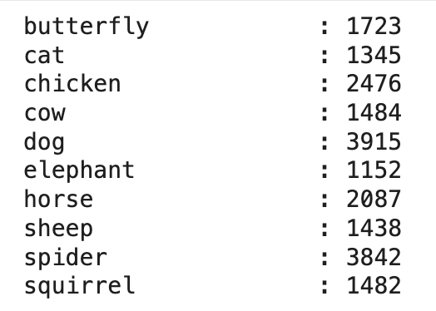
Data Validation and Preprocessing
Visually validate the data
Check class balance (data is not balanced - calculate weights)
Normalize the data: pixel values should be between 0 and 1

Slide 3
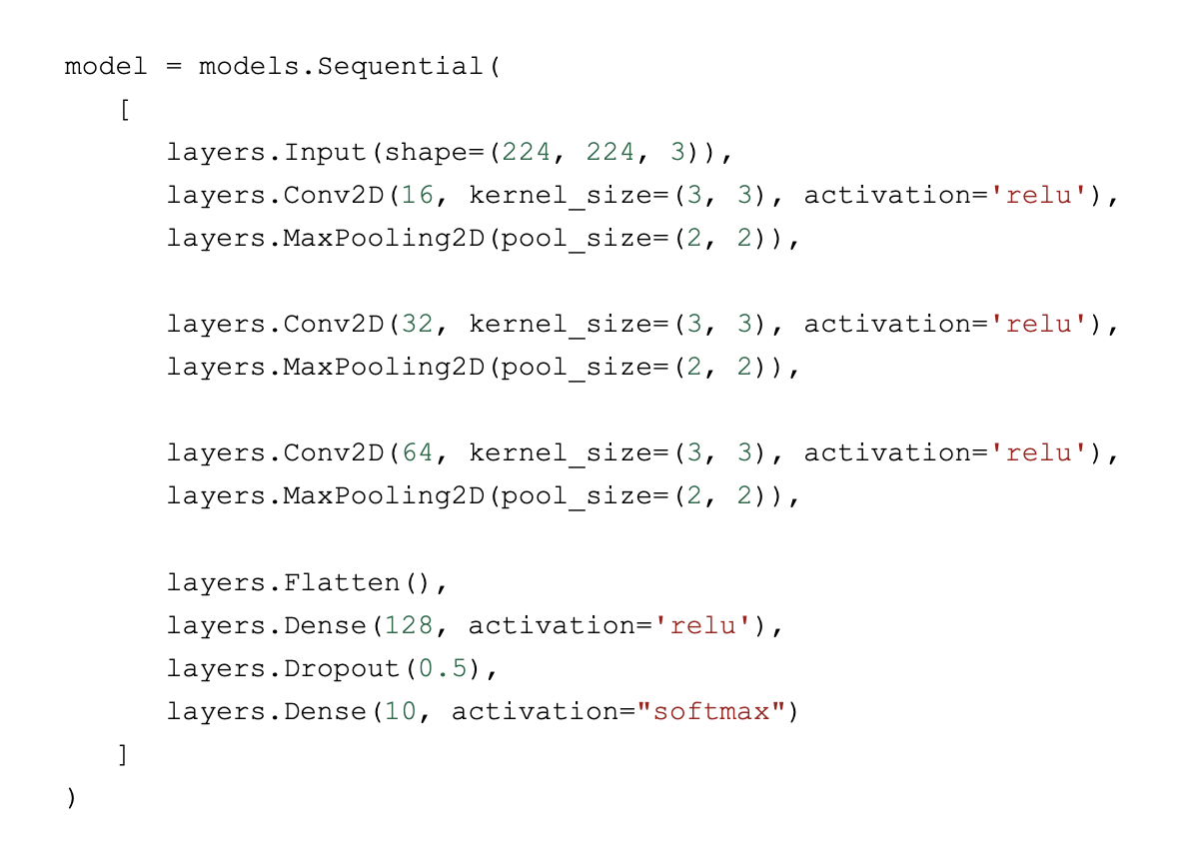
Initial Model Architecture
3 convolutional layers
Added Dropout and early stopping to prevent overfitting
Used Adam optimizer with a small learning rate (0.0001)
Started with 50 epochs, but early stopping always terminated after 20 max

Slide 4
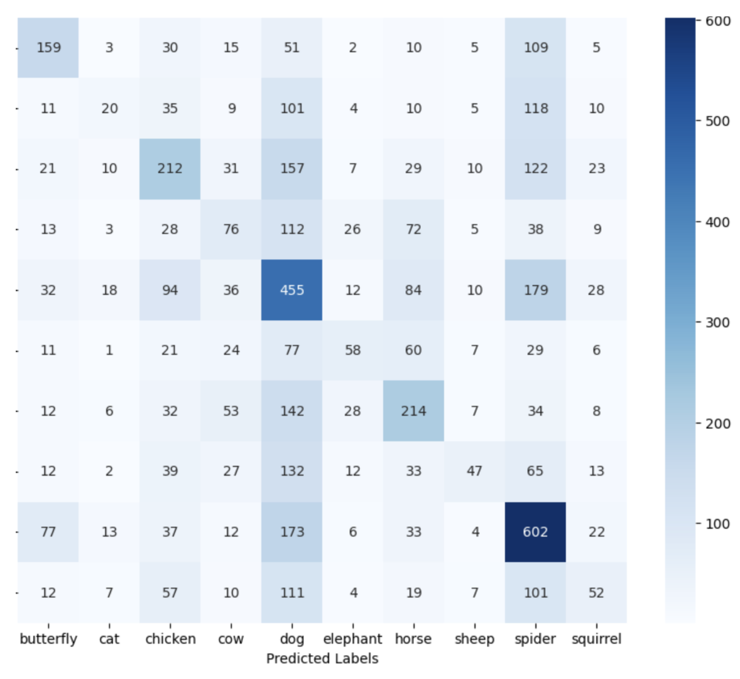
Results & Improvement Potential
Biggest problem: overfitting!
Accuracy on the training and validation sets differed by almost 0.35 (0.5 on validation, 0.85 training)

Slide 5
Second Try: Ideas to Tackle Overfitting
Added Data Augmentation (random flip, rotation, zoom, contrast) to give the model “new” images on every epoch
Replaced the standard Flatten layer with Global Average Pooling to reduce the total number of parameters and force the network to focus on the global presence of features rather than their specific location

Slide 6
Results & Improvement Potential
I was able to get the accuracy to similar values on training and validation sets (around 0.6)
However, this is still lower than I would like
The model might not be deep enough to handle the complex features of 10 different animal species - added more convolutional layers
Data Augmentation might be too strong - reduced the arguments
Implemented Batch Normalization across all five convolutional blocks to stabilize the learning process and allow for a higher learning rate
Used a ReduceLROnPlateau callback to dynamically adjust the learning rate

Slide 7
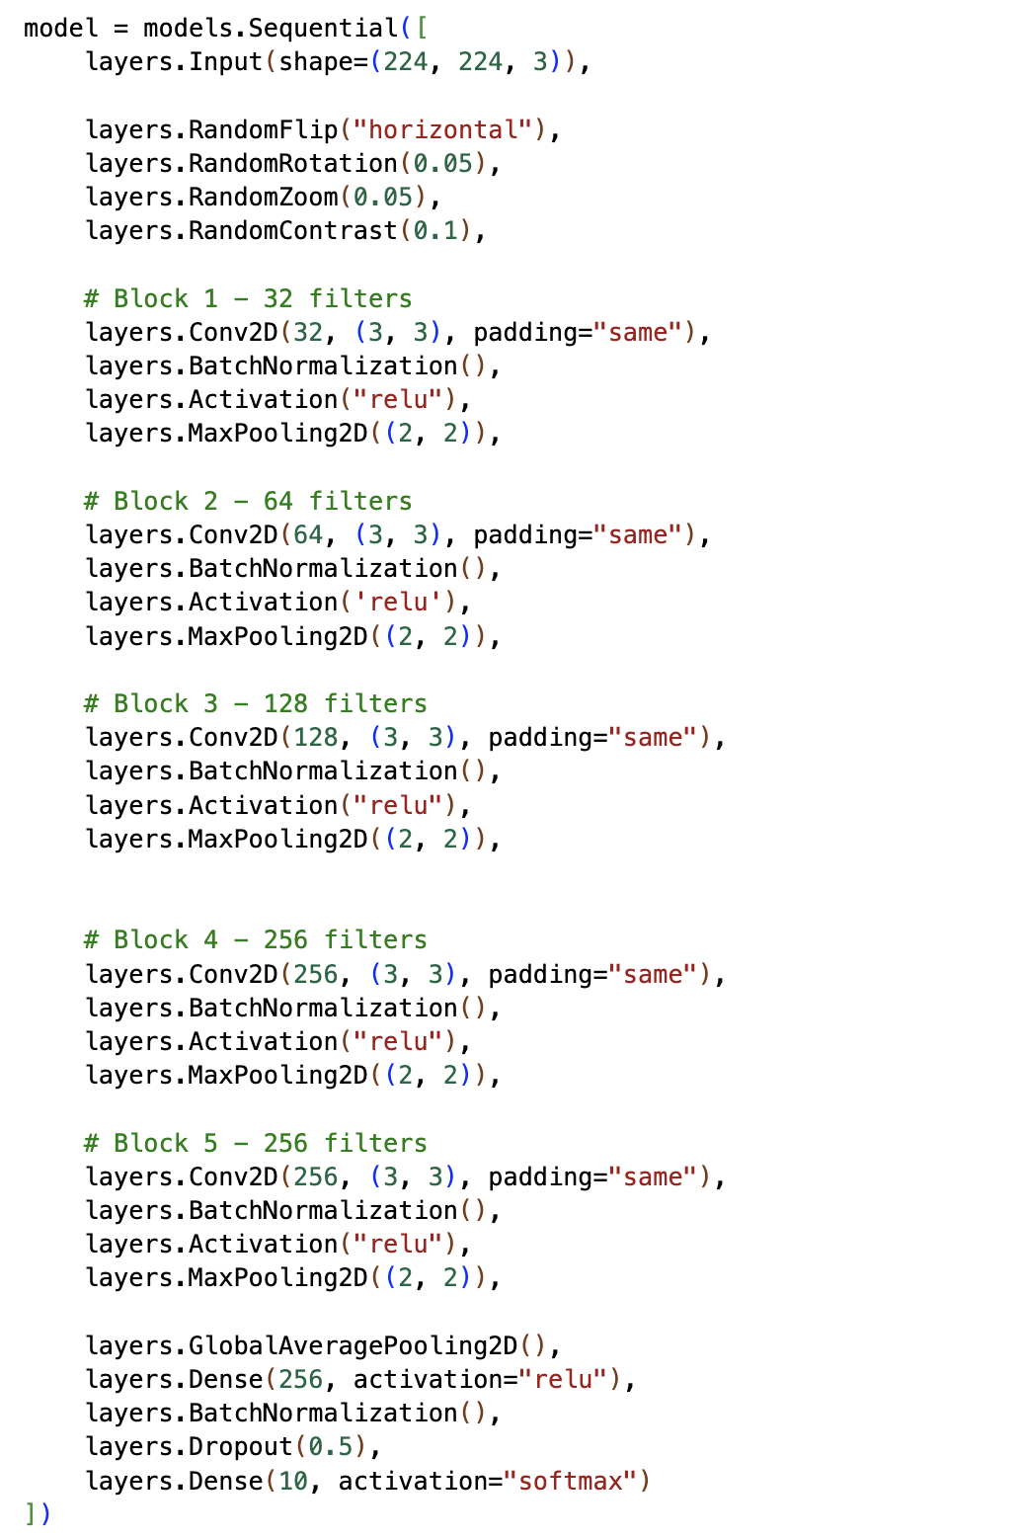
Final Architecture
After some additional experimentation, I came up with this architecture
5 convolutional layers
Batch Normalization after each layer
Positioned the Batch Normalization layers before the ReLU so that data is centered and scaled before being transformed

Slide 8
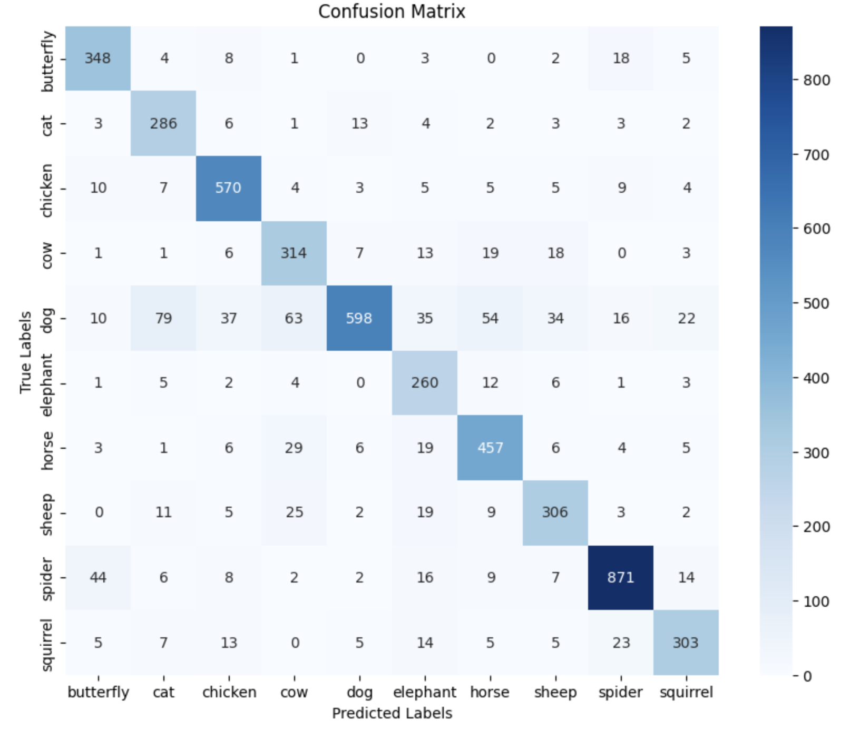
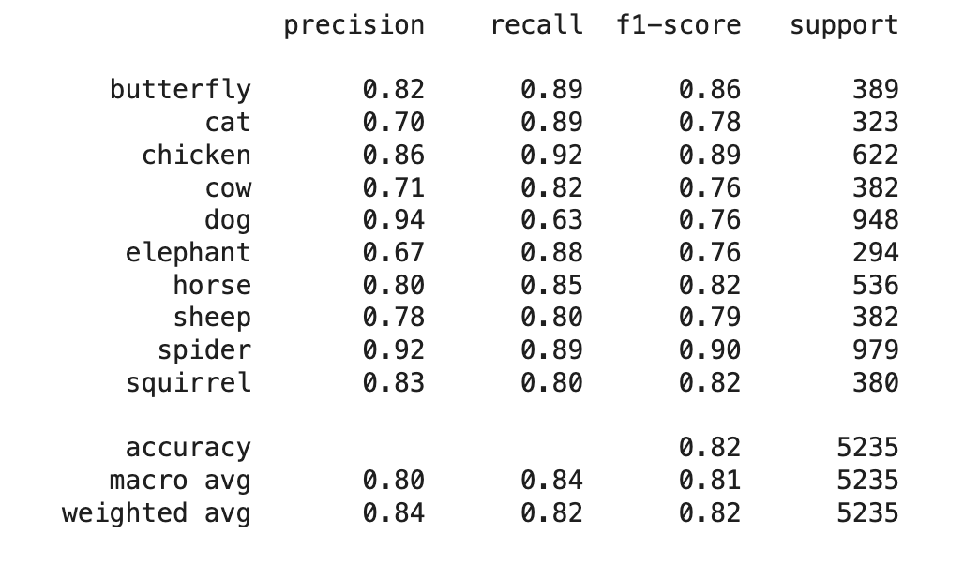
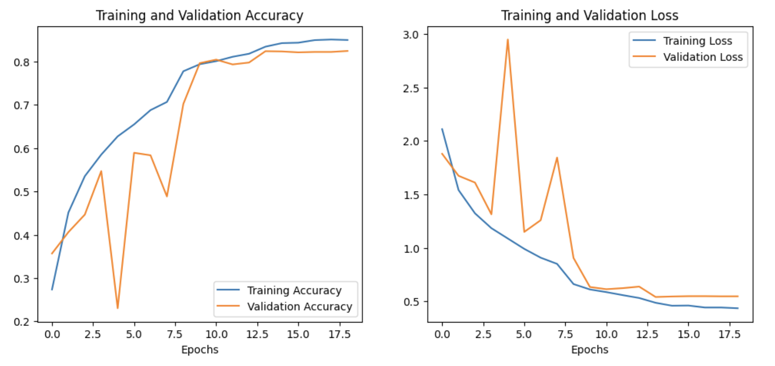
Final Results
Accuracy: 0.85 on training set, 0.82 on validation set
Precision: , recall: , F1:
Accuracy and loss curves:

Slide 9
Observations
The model produces best results with spiders and chickens - probably due to their distinct features (8 legs, beak, comb)
The recall on dogs is relatively poor - the model is highly accurate when it does predict a dog, but fails to capture 37% of the dog set
The precision on cats is relatively poor - many animals that are not cats got incorrectly classified as such
This can be explained by high confusion with other four-legged mammals and potentially similar backgrounds
Weighted average is nearly the same as macro average, suggesting that the model was able to handle unbalanced classes well

Slide 10
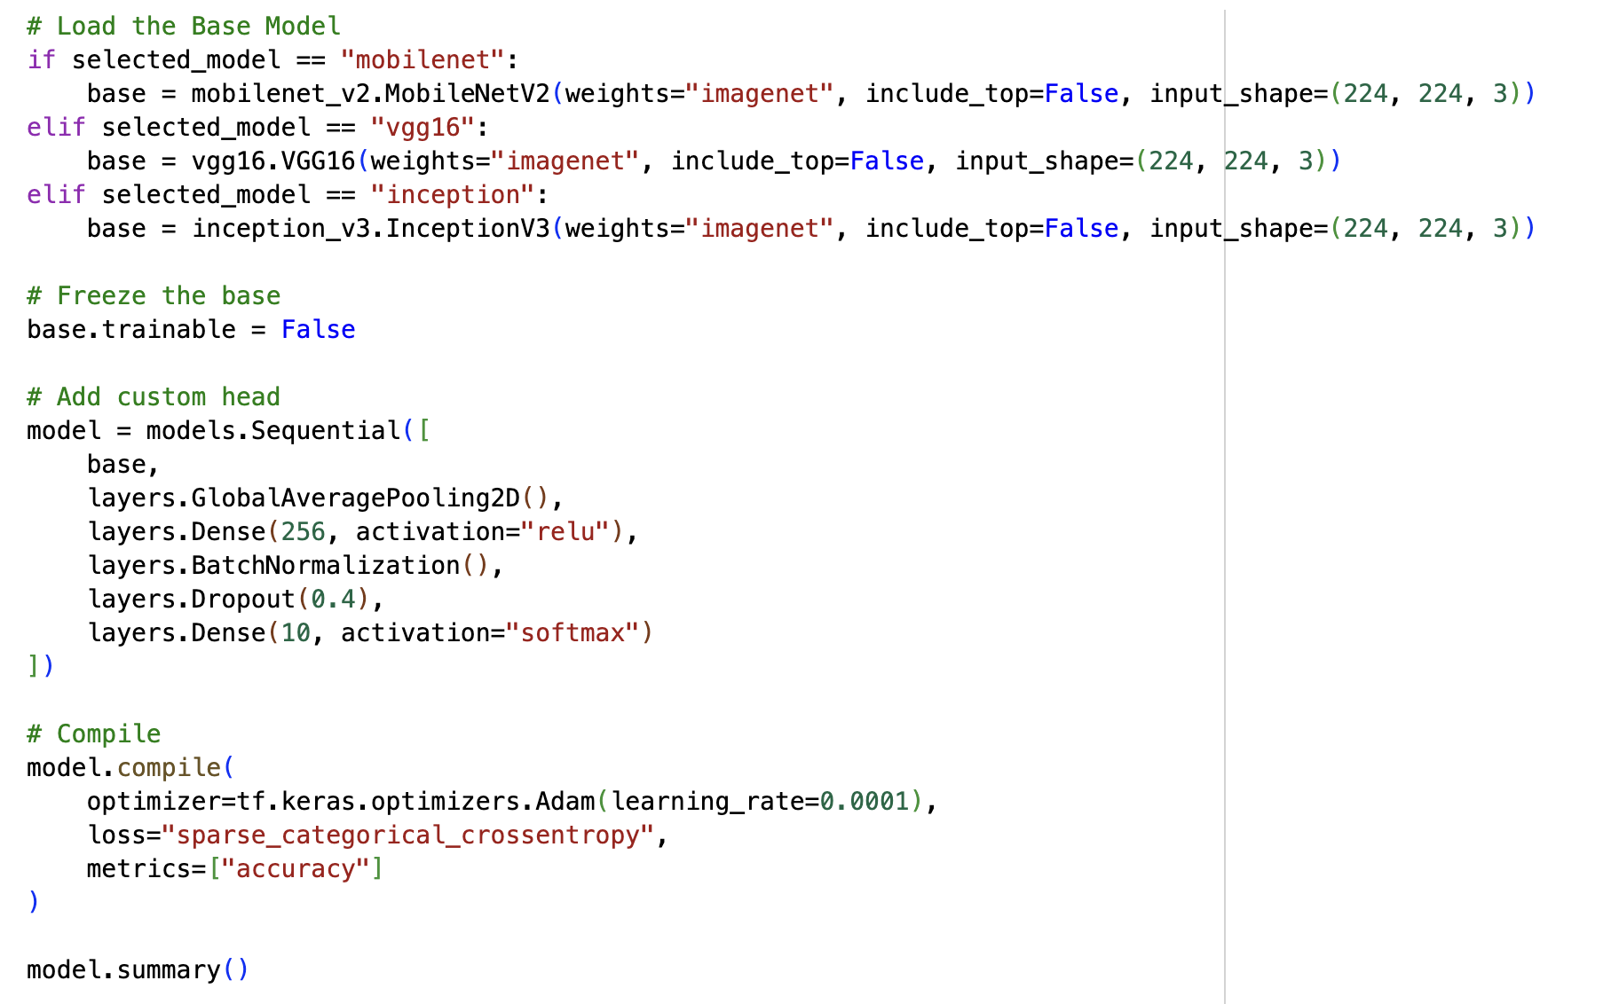
Transfer Learning
I tested 3 models: MobileNet, VGG16, and Inception
On each of them, the accuracy on the validation set was between 0.95 and 0.97
If I were to choose one for my project, I would use MobileNet as it turned out to be the most lightweight (13.6MB)
But for this project, I decided to stick to my custom model 🙂

